Slide 1
Chameli Devi Group of Institutions, Indore
Department of Computer Science & Engineering
A
Minor Project Presentation
on
AI driven Resume Screening System
GUIDED BY: PRESENTED BY:
PROF.SUMEET KOTHARI
ASSISTANT PROFESSOR
Saransh Patil 0832CS221182
Tushar Gawhade 0832CS221213
Vivek Rathore 0832CS221228
Yash Lade 0832CS221229

Slide 2
Project Overview
An AI-driven Applicant Tracking System (ATS) leverages artificial intelligence to automate and optimize the recruitment process. It streamlines candidate sourcing, screening, and selection by analyzing resumes, matching skills with job requirements, and predicting candidate success. The system improves efficiency, reduces bias, and enhances decision-making, ensuring a faster, more effective hiring process for organizations.
<AI DRIVEN RESUME SCREENING SYSTEM>

Slide 3
Objective & Scope
Objective:
  Automate candidate screening.
  Improve recruitment accuracy and reduce biases.
  Optimize the candidate-job match.
  Save time and resources for HR teams.
Scope:
  Candidate resume parsing and matching with job descriptions.
  AI-based ranking and filtering of applicants.
  Interview scheduling automation.
  Real-time reporting and analytics.
  Integration with existing HR tools.
<AI DRIVEN RESUME SCREENING SYSTEM>

Slide 4
Proposed Solution
AI and NLP for Resume Parsing :
Use Natural Language Processing (NLP) to extract skills, qualifications, and experience from resumes.
Match candidate information with job descriptions using semantic analysis.
Machine Learning for Candidate Ranking :
Develop models to rank candidates based on relevance and fit for the position.
Continuously improve the algorithm using feedback loops.
<AI DRIVEN RESUME SCREENING SYSTEM>

Slide 5
Software Model
Model Used :Agile Software Development
Iterative development :
Build, test, and improve in cycles.
Flexible approach:
Adapt to evolving requirements and feedback.
<AI DRIVEN RESUME SCREENING SYSTEM>

Slide 6
Development Phases :
Requirements Gathering: Define functional and non-functional requirements.
System Design: Architectural design, database schema, UI/UX.
Implementation: Develop ATS using AI/ML models and integration with HR tools.
Testing: Test for accuracy, performance, and security.
Deployment and Maintenance: Continuous deployment with feedback for updates.
<AI DRIVEN RESUME SCREENING SYSTEM>

Slide 7
Functional & Non-functional Requirements
Functional Requirements:
Resume Parsing : The ATS must extract relevant information (e.g., skills, experience, education) from resumes using NLP or ML-based parsing.
Job Posting and Application Management: HR personnel should be able to create job postings, view applications, and track their status.
Candidate Ranking: AI algorithms (e.g., machine learning models) rank candidates based on relevance to the job description.
Interview Scheduling: Integration with calendar systems (e.g., Google Calendar) to schedule interviews.
<AI DRIVEN RESUME SCREENING SYSTEM>

Slide 8
Functional Requirements:
Candidate Screening: Use AI to screen candidates' qualifications and skills based on predefined criteria.
Search and Filter: Ability for HR to search through candidates based on skills, experience, location, etc.
<AI DRIVEN RESUME SCREENING SYSTEM>

Slide 9
Non-Functional Requirement
Performance: The system should support a large number of applicants and job postings, ensuring scalability as user load increases.
Reliability: The ATS should have high uptime and fault tolerance to ensure continuous availability.
Security: User data must be encrypted, and sensitive information (e.g., resumes) must be securely stored and transmitted. Role-based access control (RBAC) .
Usability: The interface should be intuitive and easy for HR personnel to use with minimal training.
Scalability: The system should be able to handle increasing data volume as the number of applications grows over time.
<AI DRIVEN RESUME SCREENING SYSTEM>

Slide 10
Working of Algorithm
Resume Parsing:
Natural Language Processing (NLP) is used to extract meaningful information from resumes.
Key steps involved:
  Tokenization: Breaking the resume into words or phrases.
  Entity Recognition: Using named entity recognition (NER) to identify entities like skills, job titles, and dates.
  Text Classification: Classifying different sections of a resume (e.g., work experience, education).
  Information Extraction: Extracting and structuring the data for easier analysis (e.g., skills, experience, education).
<AI DRIVEN RESUME SCREENING SYSTEM>

Slide 11
Working of Algorithm
Candidate Ranking:
Relevance Scoring: Using algorithms like cosine similarity or TF-IDF to measure how closely a candidate’s resume matches the job description.
Machine Learning Models: Supervised learning models (e.g., Random Forest, Support Vector Machines) can be trained on labeled data to rank candidates based on features like experience, skills, and education.
<AI DRIVEN RESUME SCREENING SYSTEM>

Slide 12
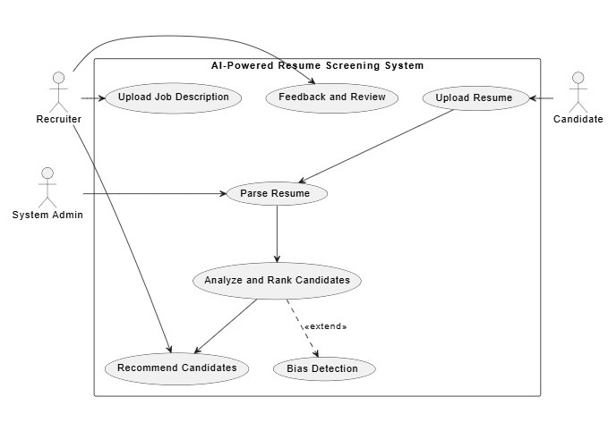
UML Diagrams
Use Case Diagram
<AI DRIVEN RESUME SCREENING SYSTEM>

Slide 13
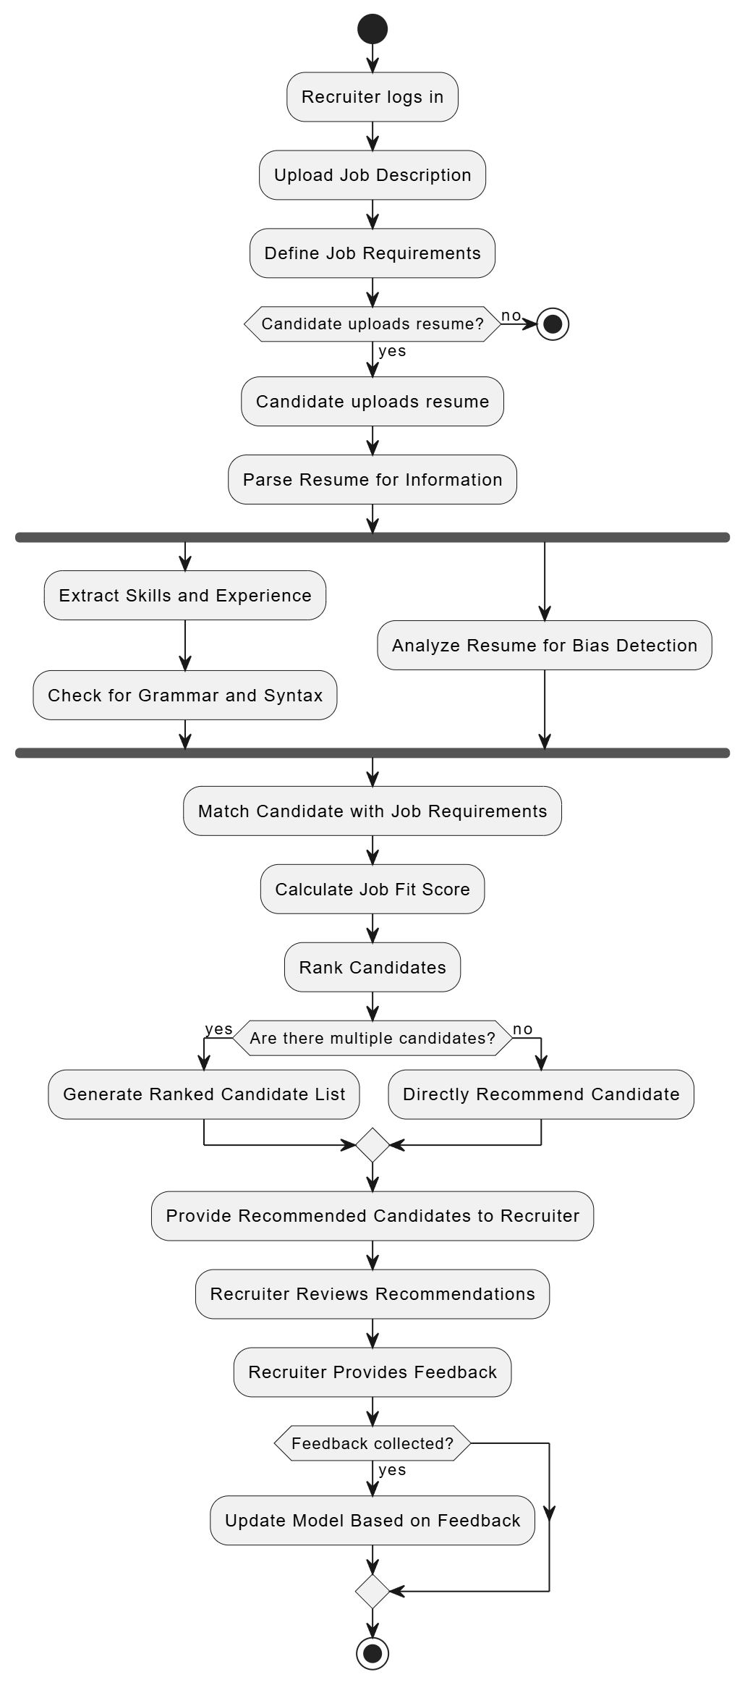
Activity Diagram
<AI DRIVEN RESUME SCREENING SYSTEM>

Slide 14
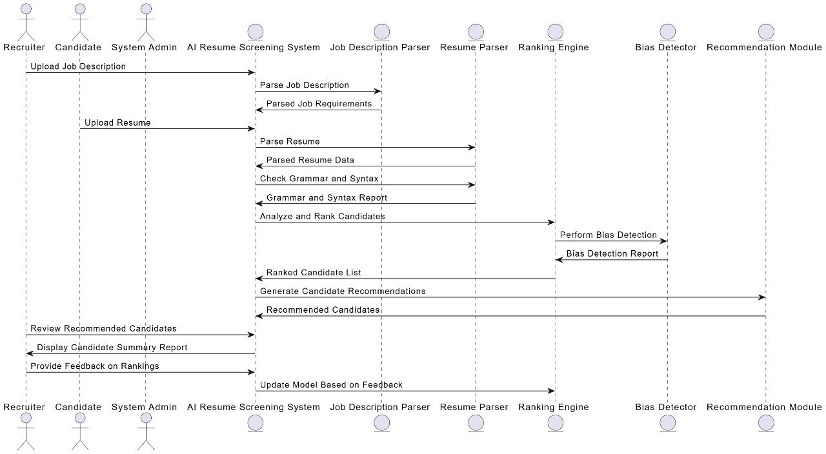
Sequence Diagram
<AI DRIVEN RESUME SCREENING SYSTEM>

Slide 15
Detailed Description of Components
Modules:
  Resume Parser: Extracts text, sections, and key points from resumes.
  Candidate Ranking Engine: Evaluates skill relevance and ranks candidates.
  Bias Checker: Ensures unbiased assessment of candidates by masking demographic data.
  Language Processor: Supports multi-language parsing for diverse applications.
  Recommendation System: Suggests alternative roles based on the candidate's profile.
<AI DRIVEN RESUME SCREENING SYSTEM>

Slide 16
Detailed Description of Components
Roles and Responsibilities:
Each module contributes to an accurate, unbiased, and efficient resume screening process. For instance:
  Resume Parser handles all unstructured data input,
  Ranking Engine ensures high-quality matching,
  Bias Checker supports diversity and inclusion.
<AI DRIVEN RESUME SCREENING SYSTEM>

Slide 17
Conclusion
Summary of Benefits:
The AI-Powered Resume Screening System reduces time-to-hire, supports fair hiring practices, and ensures higher-quality candidate recommendations.
Future Enhancements:
Potential enhancements include expanding to cover additional job sectors, integrating with applicant tracking systems (ATS), and adding predictive analytics for talent retention.
<AI DRIVEN RESUME SCREENING SYSTEM>

Slide 18
References
Research Papers and Articles:
Studies on NLP applications in recruitment and talent management.
Research on resume parsing and structured data extraction in recruitment.
Technology Documentation:
NLP libraries (e.g., SpaCy, NLTK) and machine learning frameworks (e.g., Scikit-Learn, TensorFlow).
Cloud service provider documentation for system deployment and scalability.
Articles on AI-driven bias mitigation in hiring.
<AI DRIVEN RESUME SCREENING SYSTEM>

Slide 19
Thank You
<AI DRIVEN RESUME SCREENING SYSTEM>

